Slide 1
Intelligent Career Guidance System
Submitted By:
Nilesh Chhabra – 2330590
Vanshika Nain – 2230889
Yachana Thakur – 2230898
Renuka Rani – 2330593
Date: January 2025
Under the Guidance of: Dr. Ashima Shahi (Mentor)

Slide 2

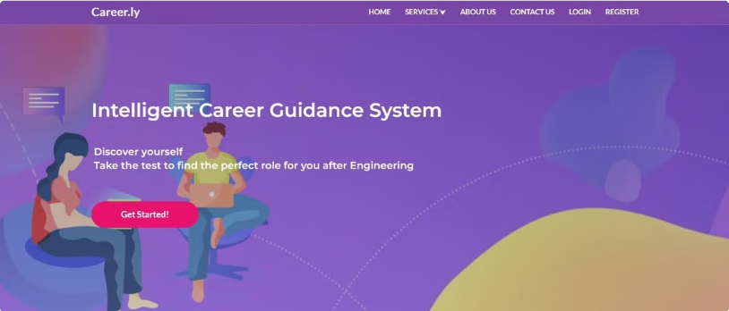
Intelligent Career Guidance System
Welcome to the future of career discovery. Our AI- powered platform is revolutionizing how individuals navigate their professional journeys through advanced machine learning algorithms that deliver truly personalized recommendations.
The Intelligent Career Guidance System (ICGS) creates a powerful bridge between individual aspirations and actual market opportunities, empowering users to make informed career decisions with confidence and clarity.

Slide 3
The Problem: Career Guidance Challenges
Outdated Approaches
Obsolete Aptitude Tests
Lack of Real-Time Guidance
Traditional career counseling relies on outdated information and generalized assessments.
Many career aptitude tests focus on roles becoming obsolete due to automation.
Individuals are ill-equipped to navigate today's dynamic job market.
Skills Mismatch
Economic Losses
A significant mismatch exists between skills, aspirations, and available opportunities.
This contributes to personal dissatisfaction and substantial economic losses.

Slide 4




Methodology
Data Collection
We gather user data from various sources. This includes resumes and skills assessments.
Algorithm Training
Data trains machine learning models. These models predict career suitability.
Recommendation Engine
Our engine suggests personalized career options. It aligns with user profiles.
Feedback Analysis
We refine results through user feedback. The system adapts and improves.

Slide 5




How ICGS Works: Technology Overview
Personalized Recommendations
1
Tailored career paths based on individual analysis
Psychometric and Skills Assessment
2
Uses psychometric tests to understand personality traits, cognitive abilities, and work preferences.
User Dashboard and Analytics
3
Provides users with visual progress charts
Machine Learning Algorithms
4
Comprehensive data analysis and pattern recognition

Slide 6




Personalized Profiling
Skills Assessment
Personality Mapping
Comprehensive evaluation across 50+ dimensions
1
2
Validated psychological models analyze traits
Education Analysis
Experience Evaluation
4
3
Academic background and learning preferences
Work history and professional achievements
The iCGS creates a dynamic user profile that continuously refines itself through ongoing interactions. This comprehensive approach ensures that recommendations evolve as users develop new skills or their interests change, providing truly personalized guidance throughout their career journey.

Slide 7
Recommendation Engine
Career Path Suggestions
Skill Gap Identification
AI-driven recommendations based on comprehensive profile analysis and alignment with market opportunities. The system suggests both traditional and non-traditional paths that match user attributes.
Detailed analysis of the skills required for recommended careers compared to the user's current skillset. The system pinpoints specific areas for development and suggests relevant learning resources.
Job Opportunity Matching
Adaptive Learning
Continuous scanning of job markets to identify specific opportunities that align with the user's profile. The system evaluates not just skill match but also cultural fit and growth potential.
The recommendation engine continuously refines its suggestions based on user feedback and interactions, becoming increasingly accurate and personalized over time.

Slide 8
User Benefits
Personalized Career Recommendations
Skill Gap Analysis & Learning Paths
Users receive tailored suggestions for career paths that align with their skills, interests, and psychometric profile, making decision-making easier and more informed.
The system identifies gaps in the user9s current skill set and recommends targeted learning resources and certifications to bridge those gaps.
Informed Decision-Making
Up-to-Date Information
Real-time integration with labor market data enables users to understand current industry trends, salary expectations, and demand for various roles.
Continuous integration with labor market trends ensures users always have the latest information about in-demand careers and emerging fields.

Slide 9




Future of Career Guidance
Global Opportunities Access
AI-Driven Dynamic Guidance
Hyper-Personalization
Education-Employment Bridge
Career guidance will become increasingly personalized, considering micro-level details such as learning pace, personality traits,
Advanced career guidance systems will expand users' horizons by providing insights into global opportunities
Leveraging artificial intelligence to provide deeper understanding of individual potential
Closing the gap between learning systems and workplace needs
The future of ICGS lies in deeper integration of AI and global data sources to offer hyper-personalized career guidance. It aims to become a lifelong companion for users, adapting to evolving job markets and personal growth.

